Slide 1
Recruiting With the Shopping Annuity™
運用購物年金作招募
Kawae Cheung
Director
高級顧問經理級
HK$138,000 in 4 Commission weeks
四個佣金週期共賺取HK$138,000
本簡報中提到的收入等級純屬舉例說明，無意代表美安香港超連鎖™店主的一般收入，也無意表示任何超連鎖™店主皆可賺取同等收入。美安香港超連鎖™店主的成功與否，取決於其在發展事業時的努力、才能與投入程度。
The income levels mentioned in the following presentation are for illustration purposes only. They are not intended to represent the income of a typical Market Hong Kong UnFranchise ™Owner, nor are they intended to represent that any given Independent UnFranchise ™ Owner will earn income in that amount. The success of any Market Hong Kong Independent UnFranchise ™ Owner will depend upon the amount of hard work, talent, and dedication which he or she devotes to building his or her Market Hong Kong Business.

Slide 2
Shopping Annuity™
Recruiting With the
Shopping Annuity™
Shopping Annuity™
Successful plan to
convert Spending into Earning

Slide 3
Traditional Annuity
You must pay extra money to receive an annuity. For example, pension.
Shopping Annuity™ What you need to do is to redirect your daily expenses to HK.SHOP.COM, you can then build your Shopping Annuity.
Notes:
TRAINERS NOTES講師備註
This is a wrap up slide – a chance for you to summarize the key points side by side.這張投影片是小結論，你可以再度說明重點。

Slide 4
What is Annuity?
A fixed sum of money paid annually in a specified period of time and can only be collected after the period expires. Aiming at securing the retired life of contributor

Slide 5
Annuity
Type | Insurance/Bank | Government
Investment | HK$5,000/month, for 20 years | HK$100K/once
Age group | Aged 35 | Aged 65
Monthly income | HK$20,000/@Aged 65-85 | HK$5,500

Slide 6
Income and
Family Expenditure
statistics
Average income per family per month:
HK$30,000
Average spending per family per month:
HK$27,627
Census and Statistics Department, HKSAR
Notes:
Population and household statistics
http://www.statistics.gov.hk/pub/B10600082015XXXXB0100.pdf
Family expenditure survey
http://www.statistics.gov.hk/pub/B11303012015AN15B0100.pdf

Slide 7
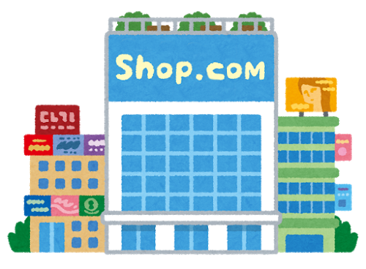
Shopping Annuity
Spending
Convert
into
Earning
& Investment

Slide 8
This is the revolution of
Consumptionand Entrepreneurship

Slide 9
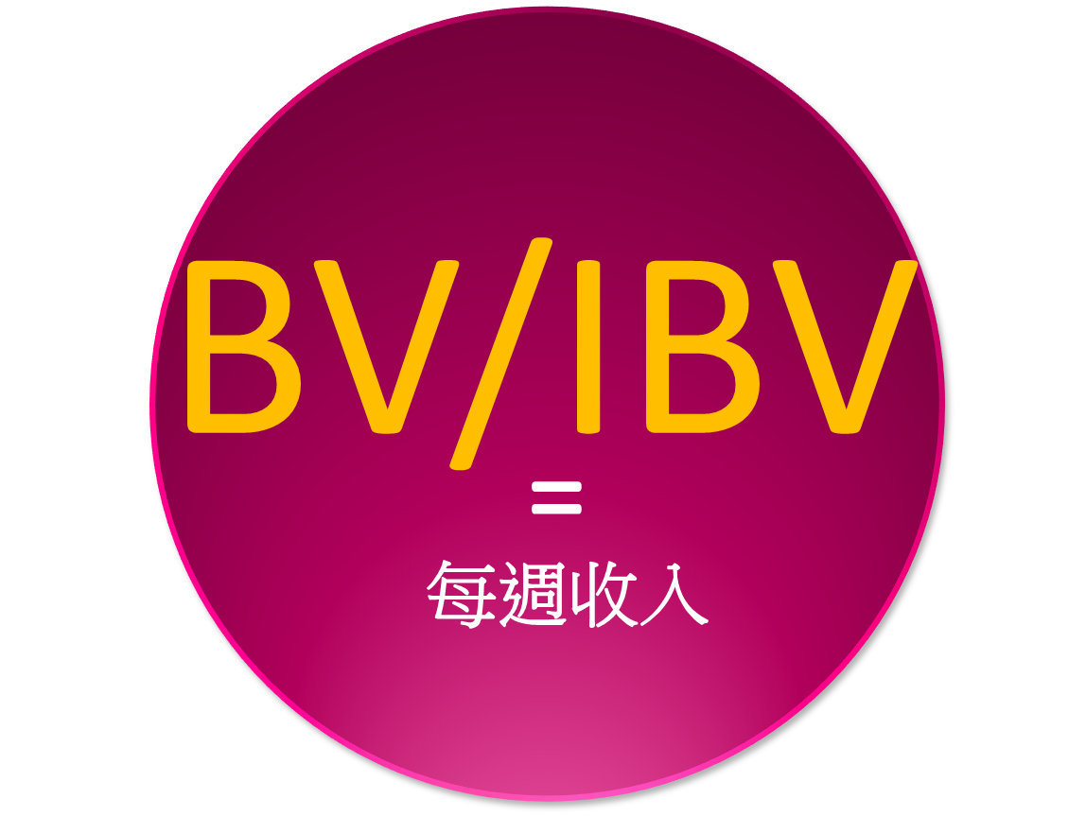
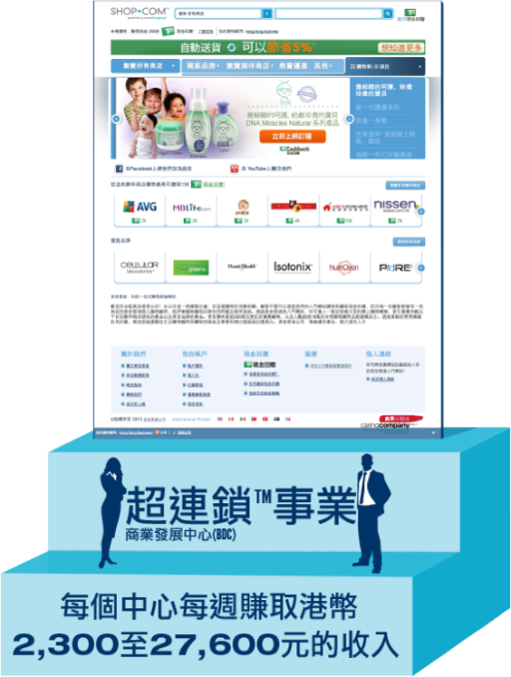
Investment income
Saving income
Salary 45 year plan
Equity funds
2-3 year plan
Bank
Generate BV continuously
Investment
Saving
$30,000
Expenditure statistics
$27,627
UnFranchise Business
Average spending per family per month:
$27,627
Weekly
Income
Ongoing income
MPCP

Slide 10
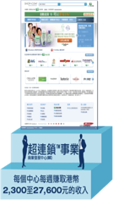
Shopping Revolution with Shopping Annuity
Household Average
Saving 36,000
Household Average
Expenditure324,000
10%
Household Income
$360,000/ year
Financial
Management
5%
1,800
16,200
Cashback
5%
90%

Slide 11
Help you earn Cashback in every way!
Fubon MHK credit card
Octopus and online payment
Partner Stores
All you need
Exclusive Agent
(numbers of MA brand)
Cover various aspects, helping consumers to earn profit
Turn consumers to business owners

Slide 12
Complete Shopping Annuity™ Assessment
How to build up Shopping Annuity?
Please download via www.shoppingannuity.com
Step 1: Analysis your spending activity
Complete Shopping Annuity Assessment and use Shop Buddy, analysis your shopping habit, to find out the potential changes of your spending to HK.SHOP.COM so that to increase your Shopping Annuity. Change your shopping activities to HK.SHOP.COM and manage your Shopping Annuity. You can convert spending into earning by saving time and money!
Shopping Annuity Assessment could help you to confirm:
Your fixed monthly consumption
Depends on different occasions, you can figure out your annual consumption (e.g. Mother’s Day, Birthday, Anniversary etc.)
It changes your shopping habits. Direct your shopping activities to HK.SHOP.COM so that you can build up Shopping Annuity.

Slide 13
Who is the one
going to change first?
ME
Start changing your shopping habits

Slide 14
How I can change?
Step 2: Find out more products and convert
- Find out products from partner stores. Purchase them and MHK exclusive products that help you to build up Shopping Annuity. The more products you can find, the more Shopping Annuity you can build up.

Slide 15
Exclusive MA
Brand
Better quality
Product
Better deal
Price
Cashback
Find out what products you can purchase in HK.SHOP.COM. Stop buying from other brands. Then you can start building up Shopping Annuity.
Notes:
TRAINERS NOTES:
Best of all, we aren’t asking you to sacrifice quality or price. Our exclusive brands are superior products, with better prices than the competition and we pay you Cashback for purchasing them.
Not to mention, by choosing these superior products, you are funding your Shopping Annuity

Slide 16
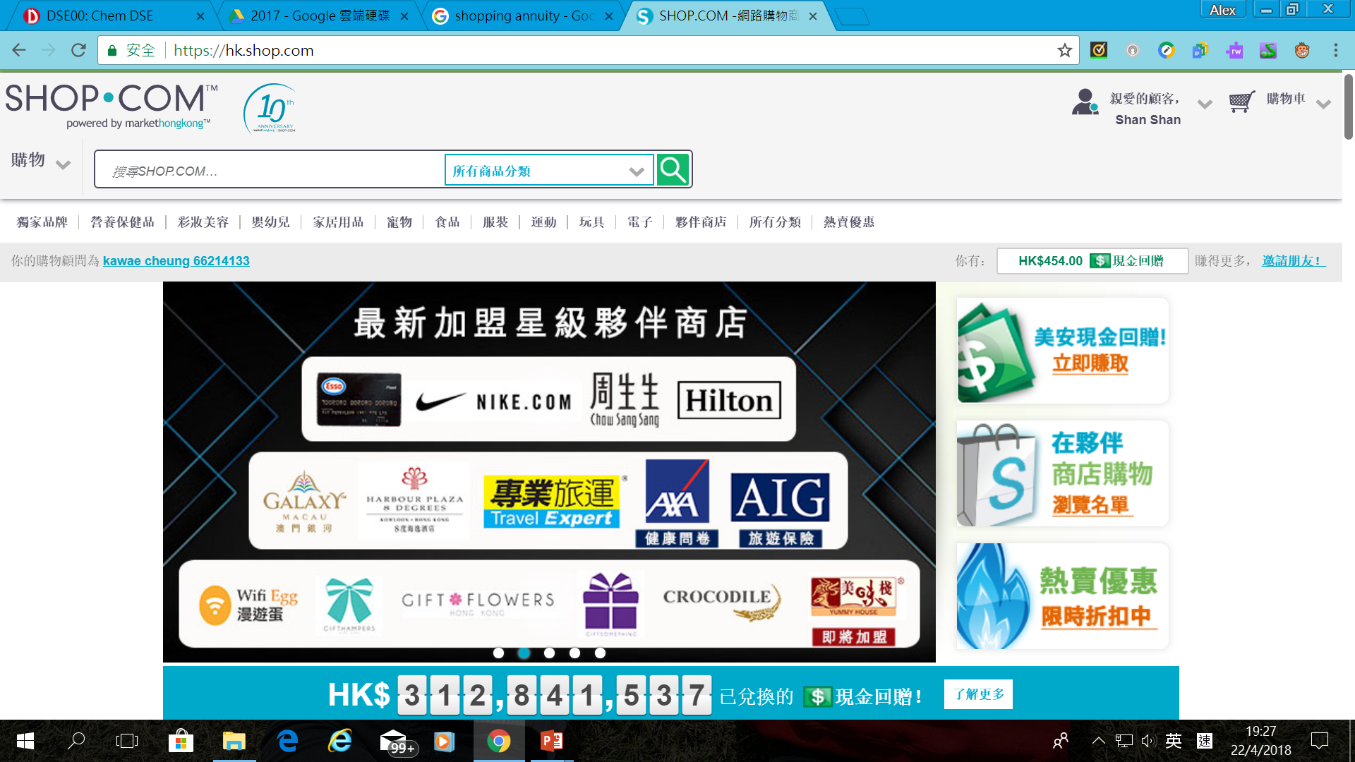
Transfer your shopping activities
via other methods
to your own HK.SHOP.COM
You can find the same items in Partner Stores.
Partner Store Shopping

Slide 17
Travel related Partner Stores
2.00%Cashback
2.00%Cashback
The Venetian Macao Resort Hotel
2.00%Cashback
3.00%Cashback
2.00%Cashback
2.00%Cashback
2.00%Cashback
3.00%Cashback
Hilton Hotel Hong Kong
2.00%Cashback
2.00%Cashback
AXA
5.00%Cashback
AIG Travel Insurance
8.00%Cashback
2.00%Cashback
5.00%Cashback
3.0%IBV
Loyal Travel Ltd
Singli Luggage
Millennium & Copthorne Hotels
2.00%Cashback
3.00%Cashback
2.00%Cashback
3.00%Cashback

Slide 18
Daily Necessary related to Partner Stores
Apple Store HK
All Sole Footware
3.0%Cashback
2.00%Cashback
3.00%Cashback
2.00%Cashback
Baby K Online Shop
2.0%Cashback
3.00%Cashback
5.00%Cashback
2.00%Cashback
2.00%Cashback
SupplyBB
4.00%Cashback
3.0%IBV
2.00%Cashback
20.00%Cashback
2.00%Cashback
Rakuten
6.00%Cashback
4.00%Cashback
2.00%Cashback
3.00%Cashback
5.00%Cashback
4.00%Cashback
3.00%Cashback
5.00%Cashback
2.0%Cashback
ProBikeKit
5.00%Cashback
3.00%Cashback
4.00%Cashback
2.00%Cashback
2.00%Cashback
6.00%Cashback
electriCITY.com.hk
3.0%Cashback
2.00%Cashback

Slide 19
Food related Partner Stores
Bon Appetit
Baby Satay
4.00%Cashback
10.00%Cashback
5.00%Cashback
2.00%Cashback
4.00%Cashback
Gyuseki Japanese Restaurant
Café 8 Degrees
2.00%Cashback
5.00%Cashback
2.00%Cashback
Harbour Plaza Hotel
The One Bakery
3.0%Cashback
4.00%Cashback
7.00%Cashback
3.0%Cashback
Dan Gor Hot Pot
4.00%Cashback
5.00%Cashback
2.00%Cashback
4.00%Cashback
5.00%Cashback
5.00%Cashback
2.00%Cashback
2.00%Cashback
5.00%Cashback
5.00%Cashback
4.00%Cashback
2.00%Cashback
Sashi Japanese Yakiniku Restaurant
2.00%Cashback
5.00%Cashback
5.00%Cashback
Royal Garden
LDF(FOOD)LTD
7.00%Cashback
5.00%Cashback
2.00%Cashback
COFFEE N TEA SUPPLIES COMPANY
5.00%Cashback
2.00%Cashback

Slide 20
YOU’RE ALREADY SPENDING IT
Why not convert your spending into earning?

Slide 21
Social Media
The largest sponsoring program in history

Slide 22
Willingness
to share

Slide 23
Under the low bank exchange rate today, do you have enough cash for investment?
UnFranchise™ Ongoing Income | Investment Rule of 4%
$2,300 / month | $690,000
$11,500 / month (Executive Coordinator) | $3,450,000
$34,500 / month (Professional Coordinator) | $11,040,000
$76,600 / month (National Supervising Coordinator) | $24,512,000
$138,000 / month (Director) | $44,850,000
$276,000 / month ( Field Vice-President) | $92,000,000
UnFranchise™ Income
vs. Investment rule of 4%
Notes:
TRAINERS NOTES:
The 4% Rule is a popular investment-income strategy that says as long as you withdraw no more than 4% of your initial portfolio, adjusted for inflation, on an annual basis during your retirement years, you shouldn't run out of money.
Take a look at what it would take to create a $4,600/month payment to yourself at retirement, following this rule. It would take $450,000 in the bank! Would you have that money saved up by retirement?
Most Americans are living paycheck to paycheck with little to no savings. How will they get it done? The answer is that most won’t, and therefore will never have the 4% rule as a viable retirement option.
With Market America, you could create a $4,600 / month asset as an executive coordinator or master coordinator. And even more, after 2-3 years of following our proven plan you could create a residual income of $1,420,000 / year. That is the equivalent of living off of 4% of a $5MILLION asset in the bank!
Think even further – if you built the UnFranchise as a way to enjoy residual income because you didn’t have the savings to participate in the 4% rule, now you can create the savings and earn both – the Residual Income from your UnFranchise and the 4% off the income you save!

Slide 24
Assets inherited through generations
You are able to earn ongoing income for HK$2300 - $27,600 per week
You can leave your savings to your family and posterity
Notes:
TRAINERS NOTES:
How can you keep your hard earned assets in the family?
Your UnFranchise is a willable asset and can be willed to family and generations to come.

Slide 25
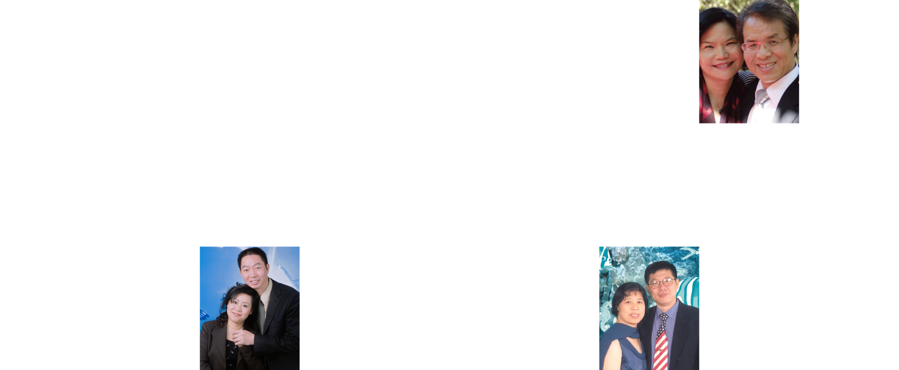
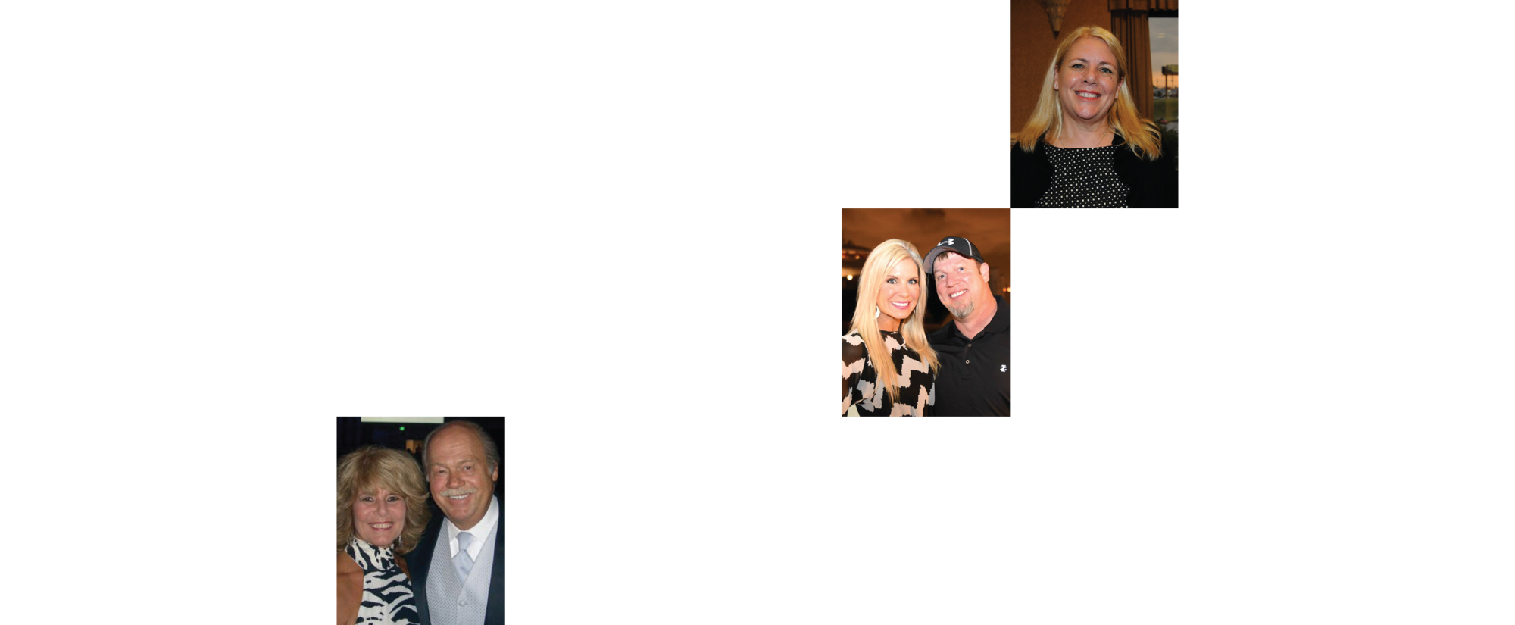
Earned over 1 million US dollars commission
Market America|SHOP.COM is changing people shopping habits; All of us are able tocreate our own economic foundation until financial independent.

Slide 26
Shopping Annuity™
Shopping Annuity™
Successful plan to
convert Spending into Earning

